Slide 1
Regression Analysis
It is a statistical tool to find the relationship between one dependent variable and one or more independent variables.
Example: Consider a Sales Company Dataset and you are a Marketing Analyst of the company.
Let the dataset has attributes like Adv. Cost (Rs.) and Sales Amount (Quantity)
Adv. Cost (Rs.) Sales Amount
1 1
2 1
3 2
4 2
5 4

Slide 2
Regression Analysis
Here, we may decide how much money we can spent for advertising. So, amount of money spent is the controlled variable .
But, we can’t control the Sales amount, so it is not a controlled variable. This is dependent variable depends on Advertising Cost.
This is not only the factor, Sales amount may also dependent on some other factors like no. of persons working, etc.
Adv. Cost : X→ Independent or Regressor Variable
Sales Amount: Y →Dependent or Response or Random Variable

Slide 3
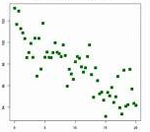
Regression Analysis
Scatter plot is a mathematical diagram to display values of two variables for a set of data.
It is used to investigate
the possible relationship
between the variables.
If it indicates the linear
relation then linear regression is consider; otherwise polynomial regression, and so on are considered.
Sales Amount
Adv. Cost

Slide 4
Simple Linear Regression (SLR) Model
It is a model with a single regressor variable X that has linear relationship with a response variable Y.
The simple linear regression model is:
Y = a + cX + ϵ, where a→ intercept, c→ Slope, and ϵ is a random error component.
=> For a given X, the corresponding observation Y consists of the value a + cX + ϵ.
The same model may be written as:
y_{i} = a + cx_{i} + ϵ_{i} for i = 1, 2, …, n; n is the no. of observations.

Slide 5
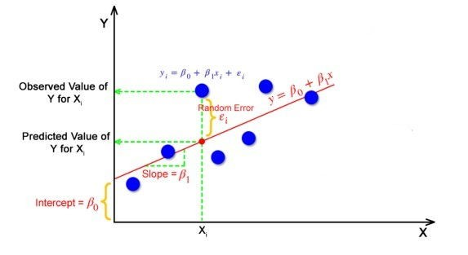
Simple Linear Regression (SLR) Model

Slide 6
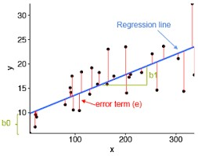
Simple Linear Regression (SLR) Model
Let the best fitted model is:
Ŷ = â + ĉX or
ŷ_{i} = â + ĉx_{i}; i=1,2,…,n
The line fitted by Least Square Method (LSM) which makes the sum of square of all vertical discrepancies as small as possible.
The LSM estimates the parameters a and c using the dataset <X, Y> as â and ĉ.
X Y
x₁ y₁
x₂ y₂
x_{i} y_{i}
x_{n} y_{n}

Slide 7
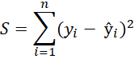
Simple Linear Regression (SLR) Model
The cost function or error function of the LSM is:
We estimate a and c so that sum of square of all the differences between the observed y_{i} and the predicted ŷ_{i} is minimum, i.e., S is minimum.
This S is called Sum of Square Residual, i.e., SS_{Res} =
Residual = Deviation between actual and predicted value
Error = Deviation between actual value and mean of population.
X Y
x₁ y₁
x₂ y₂
x_{i} y_{i}
x_{n} y_{n}

Slide 8
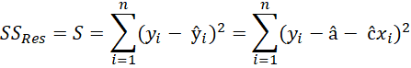
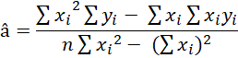
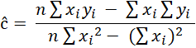
Parameter estimation using LSM
By taking the partial derivatives = 0 and solving, we get the best fitted model is:
Ŷ = â + ĉX , where

Slide 9
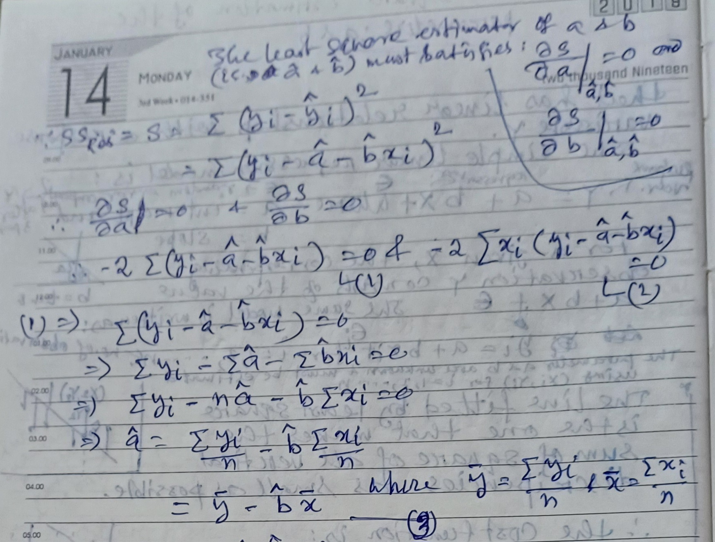
Parameter estimation using LSM

Slide 10
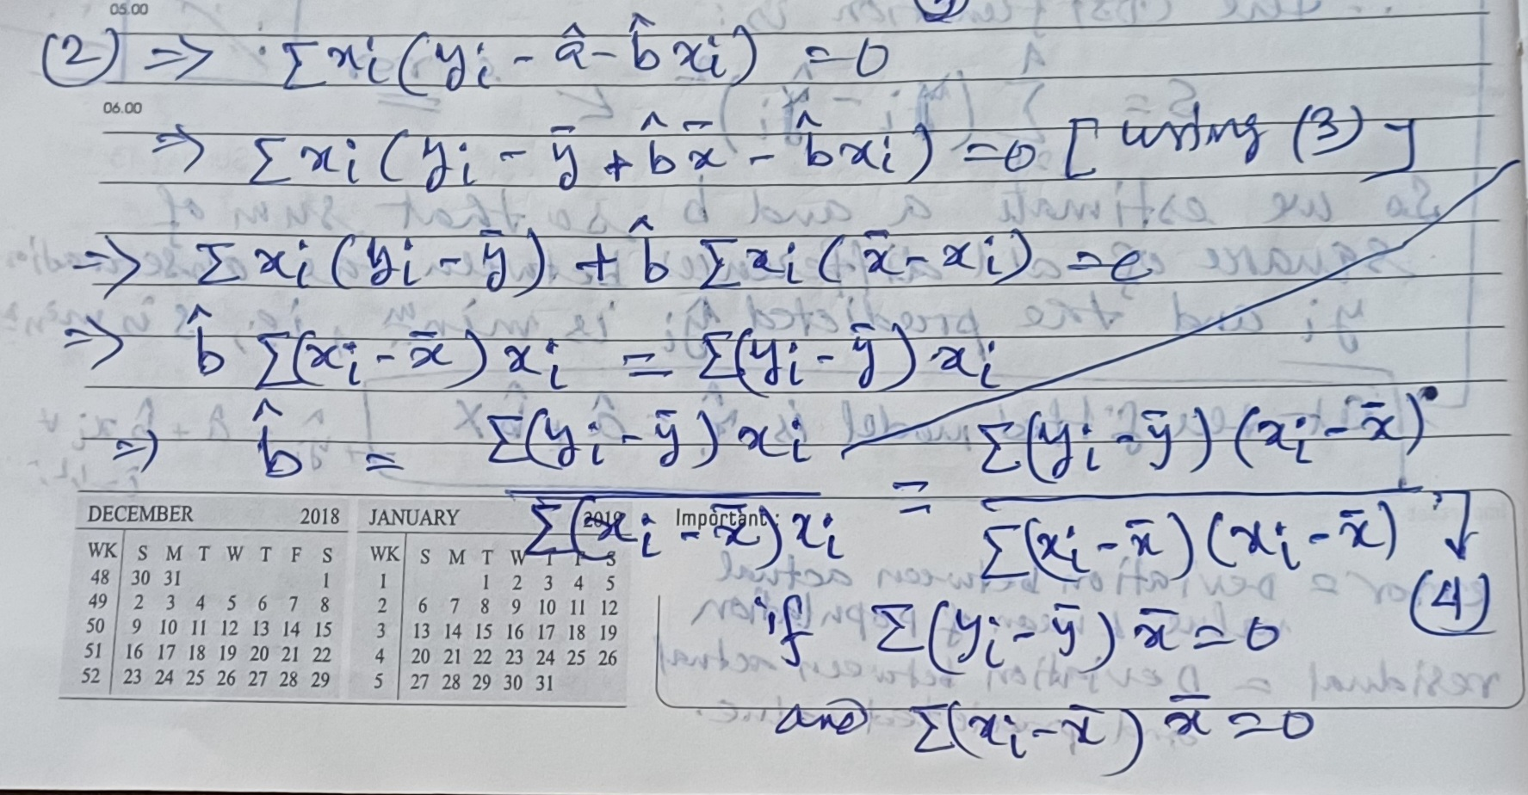
Parameter estimation using LSM

Slide 11
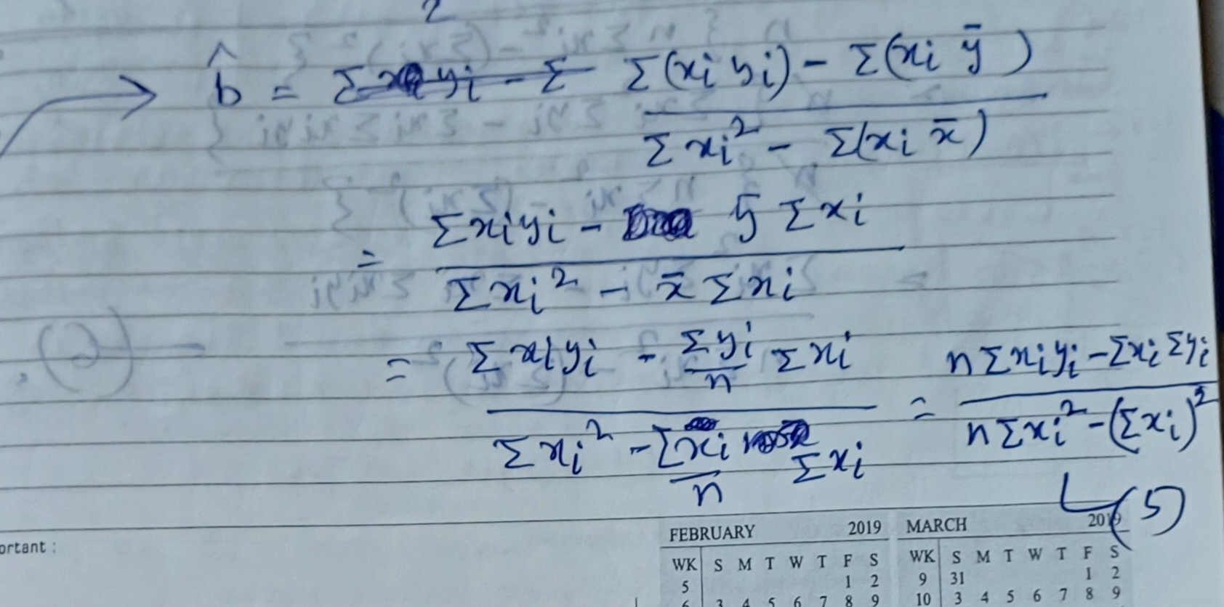
Parameter estimation using LSM

Slide 12
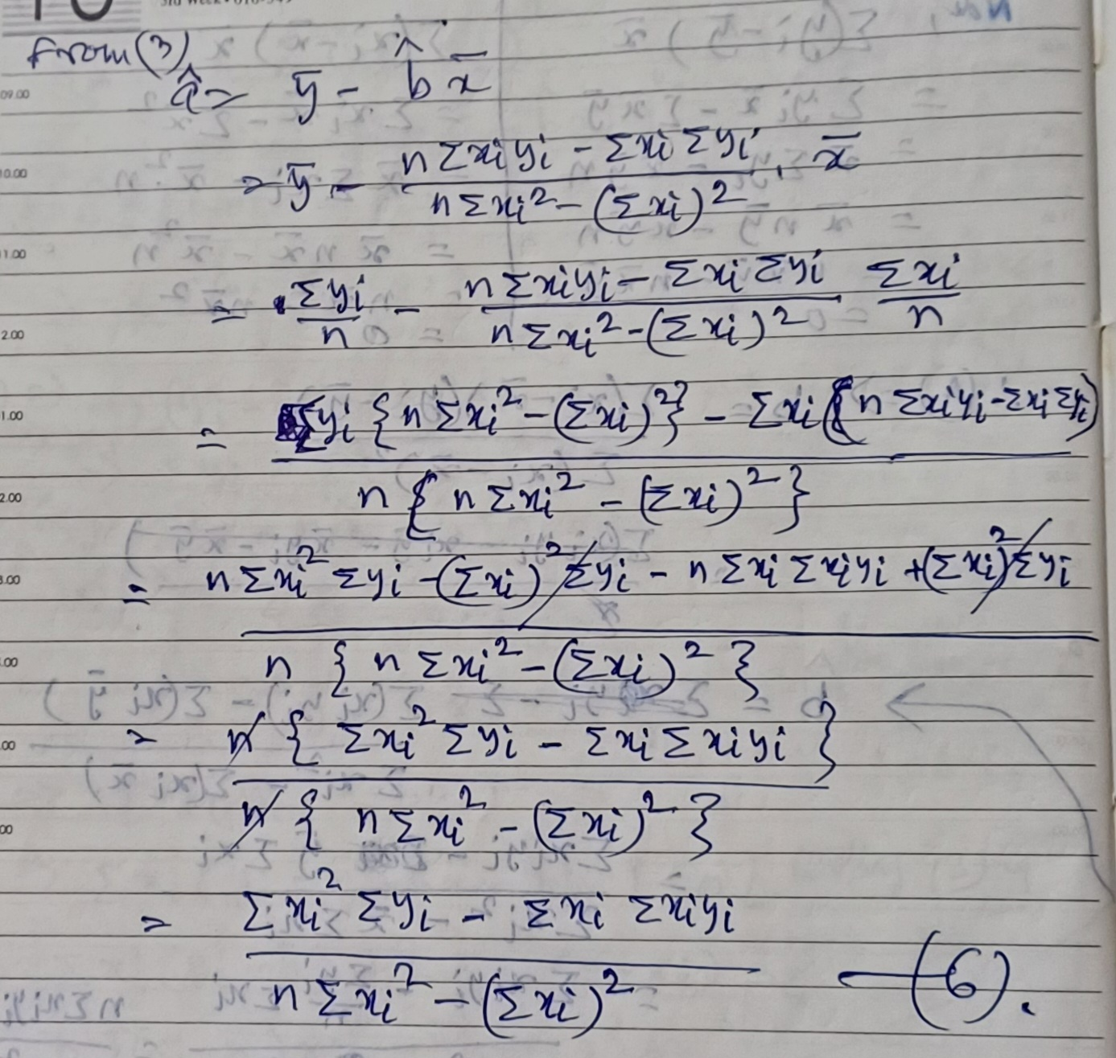
Parameter estimation using LSM

Slide 13
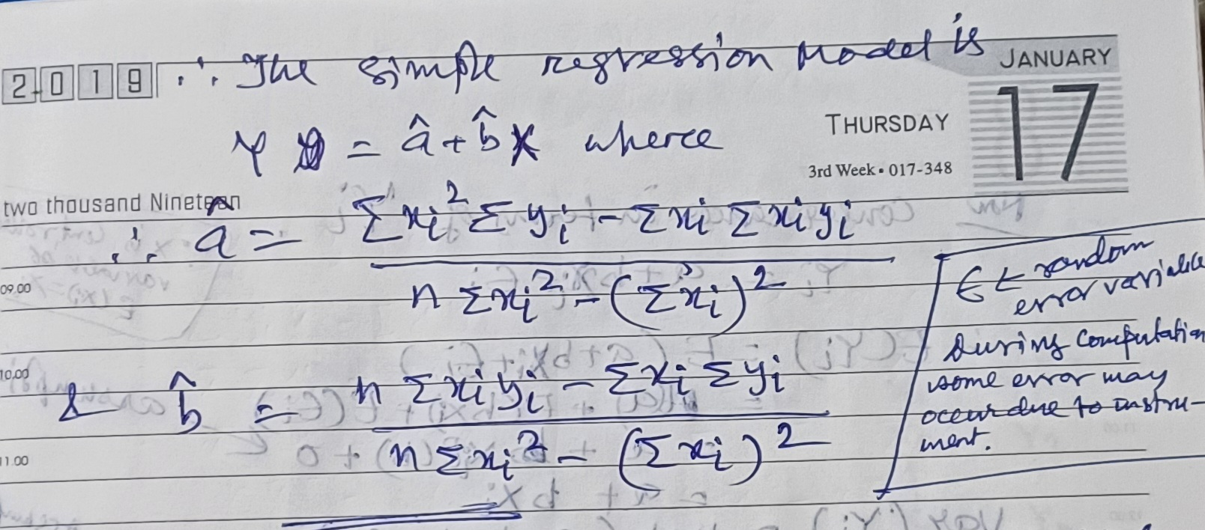
Parameter estimation using LSM

Slide 14
Basic Assumptions on SLR Model
In simple LRM, y_{i} = a + cx_{i} + ϵ_{i} for i = 1, 2, …, n :
ϵ_{i} is a random variable with zero mean and variance σ² (Unknown), i.e., E(ϵ_{i})=0 and Var(ϵ_{i})= σ²
ϵ_{i} and ϵ_{j} are uncorrelated, i ≠ j, i.e., COV(ϵ_{i},ϵ_{j}) = 0
ϵ_{i} is a normally distributed random variable with zero mean and variance σ². i.e., ϵ_{i} ~ N(0, σ²)
So, ϵ_{i}‘s are normally distributed and uncorrelated => ϵ_{i}’s are independent.

Slide 15
Consequences in terms of y_{i}
y_{i} = a + cx_{i} + ϵ_{i} for i = 1, 2, …, n :
E(y_{i}) = E(a + cx_{i} + ϵ_{i})
= E(a) + E(cx_{i}) + E(ϵ_{i})
= a + x_{i} E(c) + 0 [as x is controlled variable, and E(ϵ_{i})=0]
= a + cx_{i}
ii) Var(y_{i}) = Var(a + cx_{i} + ϵ_{i})
= Var(a) + Var(cx_{i}) + Var(ϵ_{i})
= 0 + 0 + σ² = σ²
Since, ϵ_{i} follows normal distribution with zero mean and σ²
variance, so the consequence of y_{i} is that y_{i} follows normal
distribution with a + cx_{i} mean and σ² variance,
i.e., y_{i} ~ N(a + cx_{i}, σ²)

Slide 16
Consequences in terms of y_{i}
So, we assume that, i-th observation, y_{i} is from normal distribution with mean = a + cx_{i} and Var = σ² (Also, y_{i}’s are uncorrelated and independent)
Therefore, given a set of data, the dataset must satisfy this assumptions.
If the assumptions are not hold, then we should not apply this regression analysis. This is verify using topic modeling adequacy checking (study in your own, if interested).

Slide 17
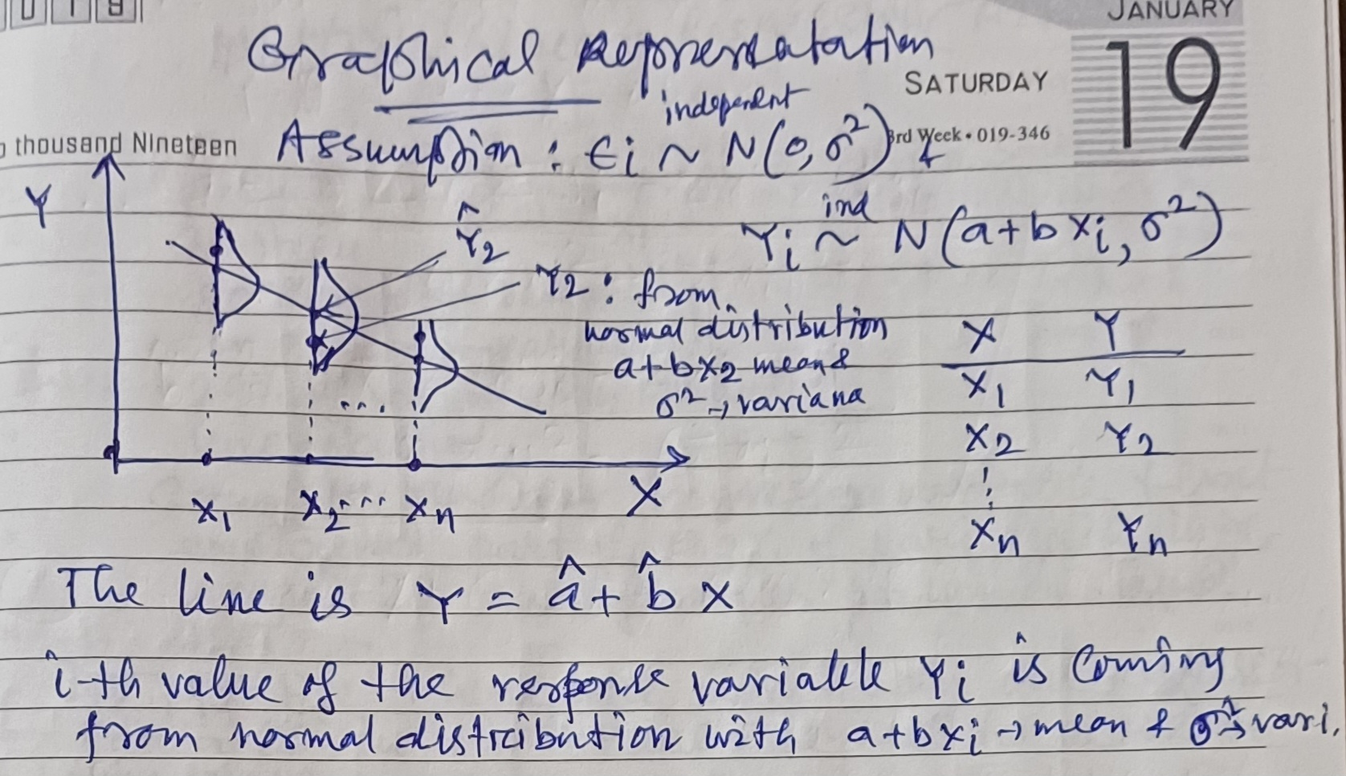
Graphical interpretation of Assumptions in SLR Model

Slide 18
Multiple Linear Regression (MLR) Model
Consider the same Company Sales Dataset.
In case of SLR, we assume that the response variable “Sales Amount” is fully explained by the regressor variable “Adv. Cost”
But in reality, it may be say, 80% explained by “Adv. Cost”. Remaining 20% may be explained by other factor, say “No. of sales person” employed.
In practice, there are more than one regressor variables, in that case, we consider MLR.

Slide 19
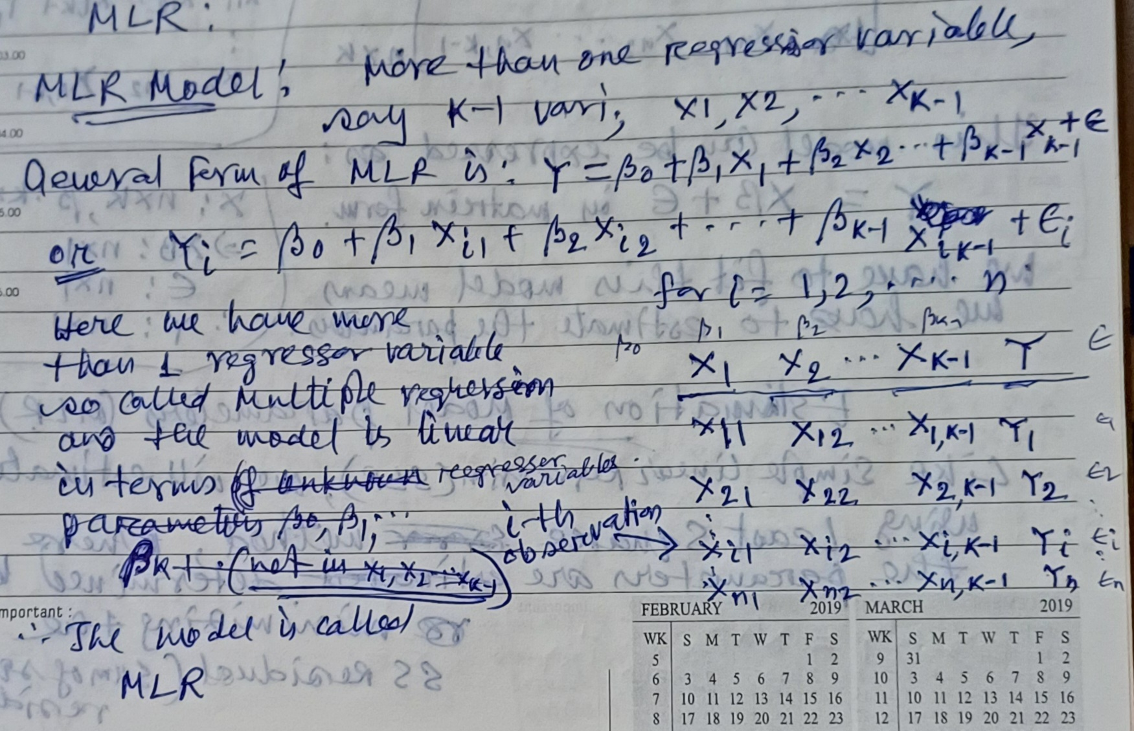
MLR Model

Slide 20
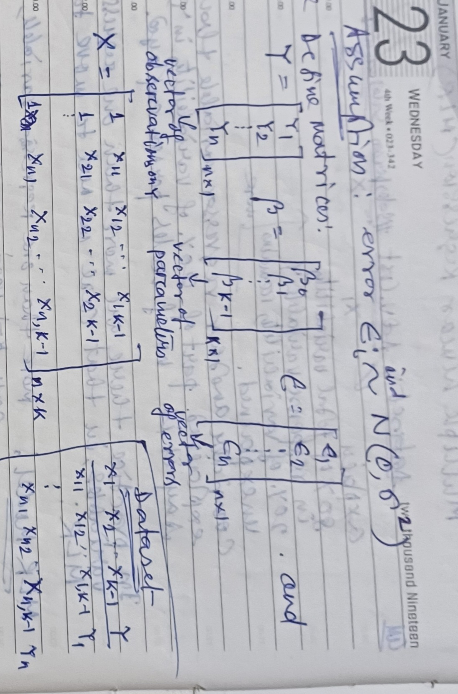
MLR Model

Slide 21
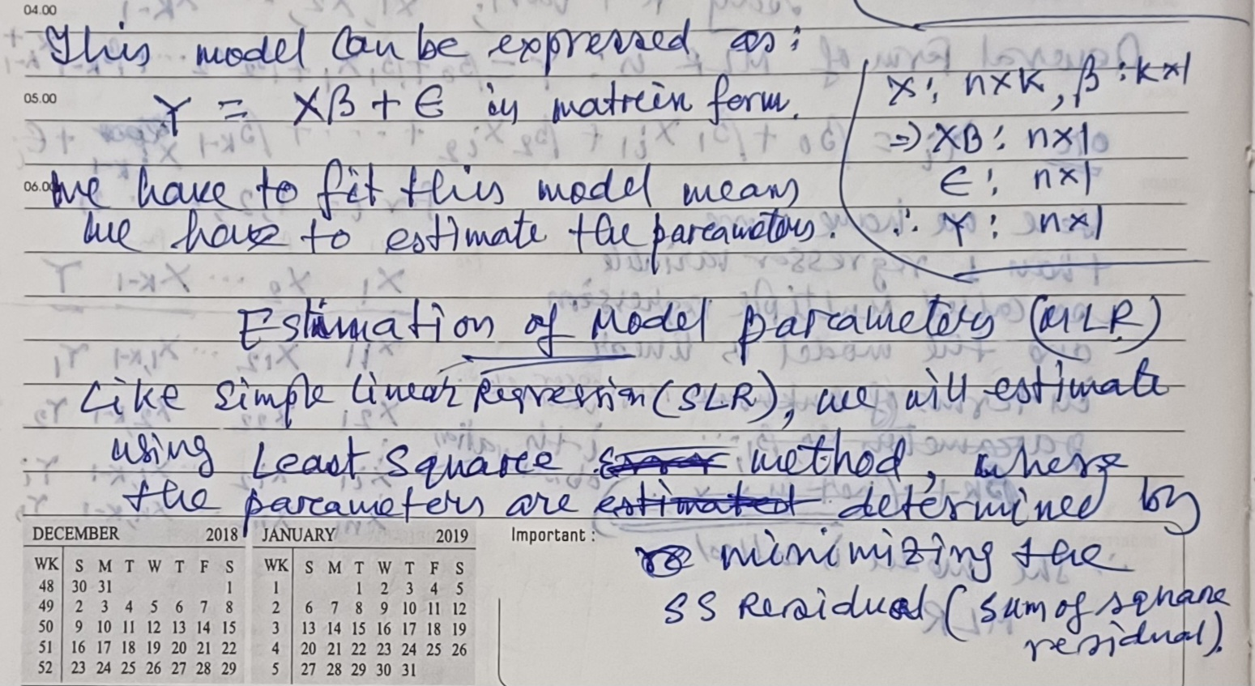
MLR Model

Slide 22
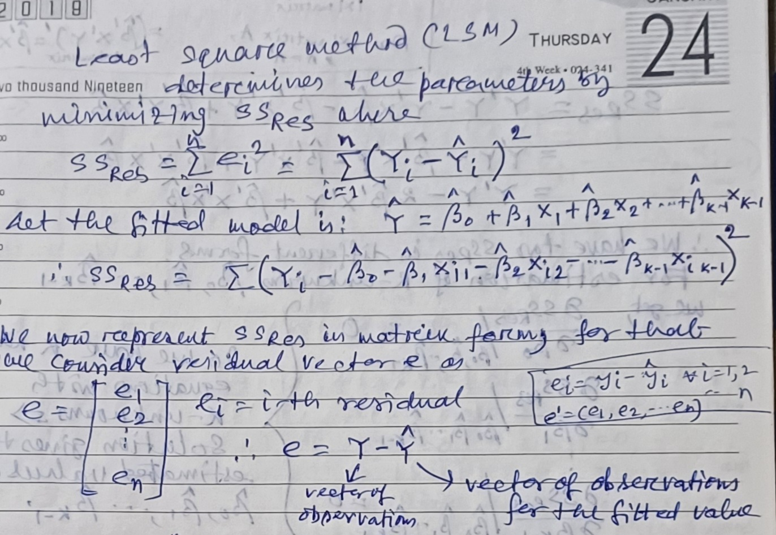
MLR Model

Slide 23
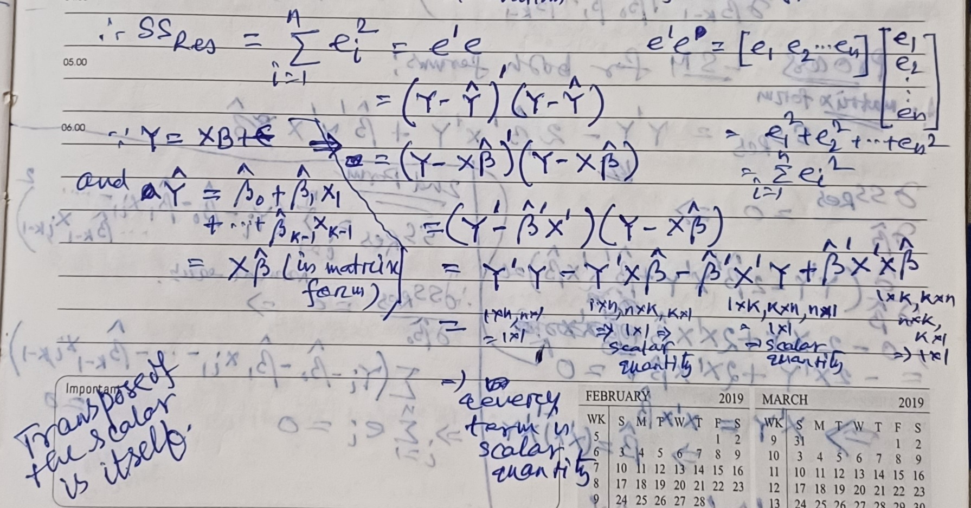
MLR Model

Slide 24
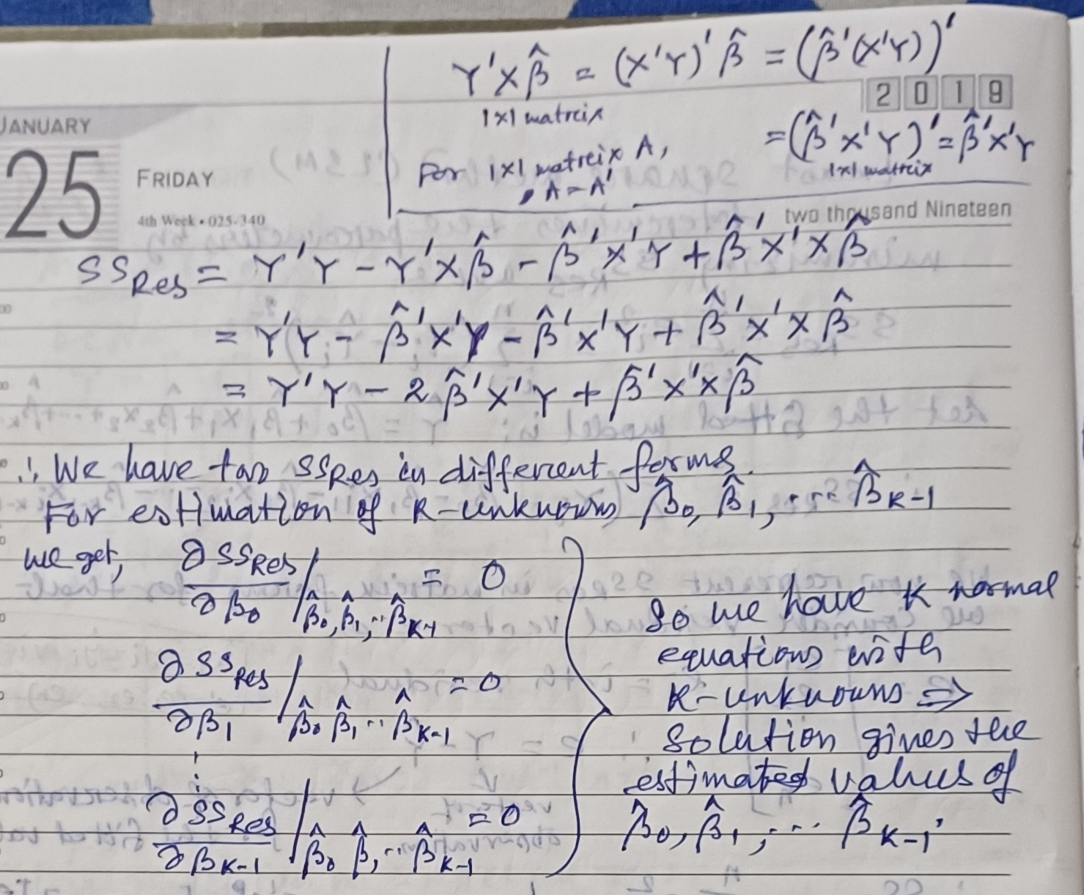
MLR Model

Slide 25
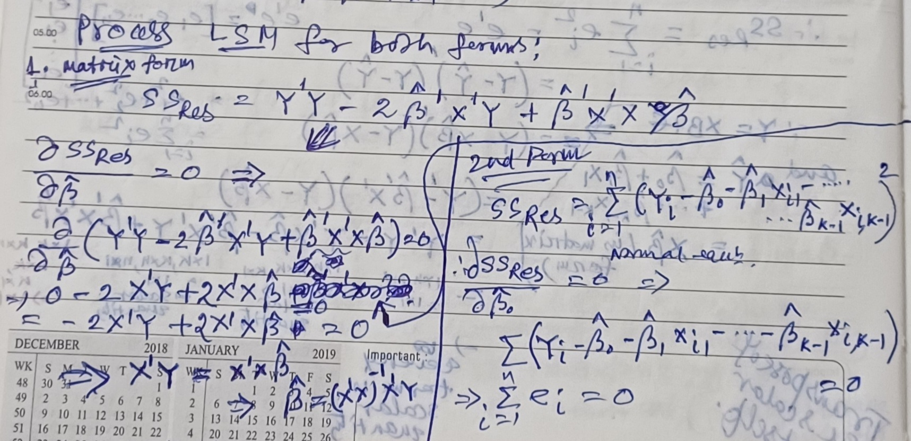
MLR Model

Slide 26
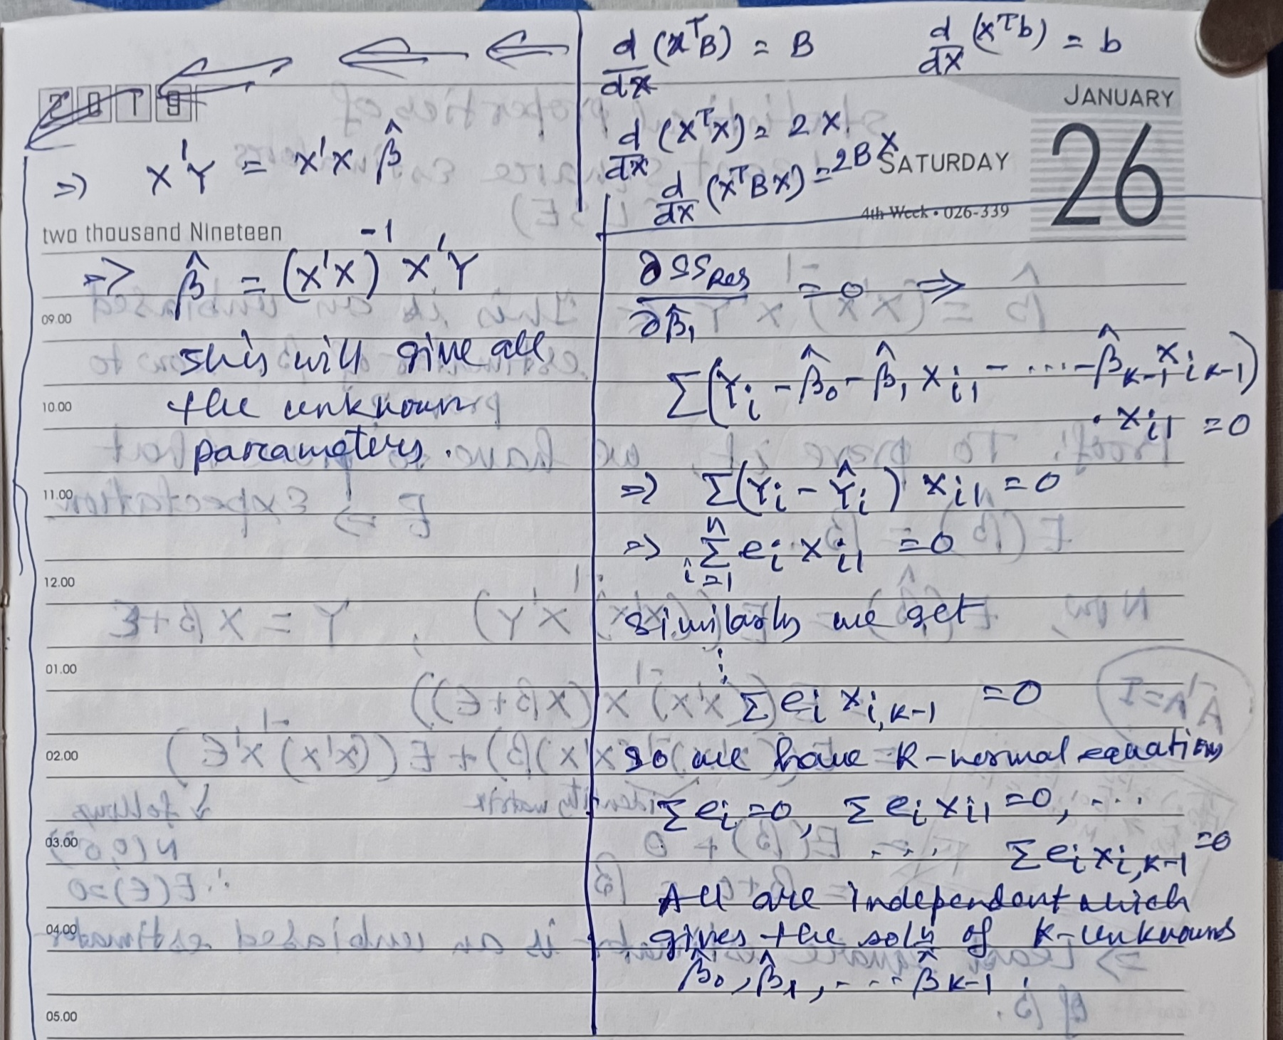
MLR Model

Slide 27
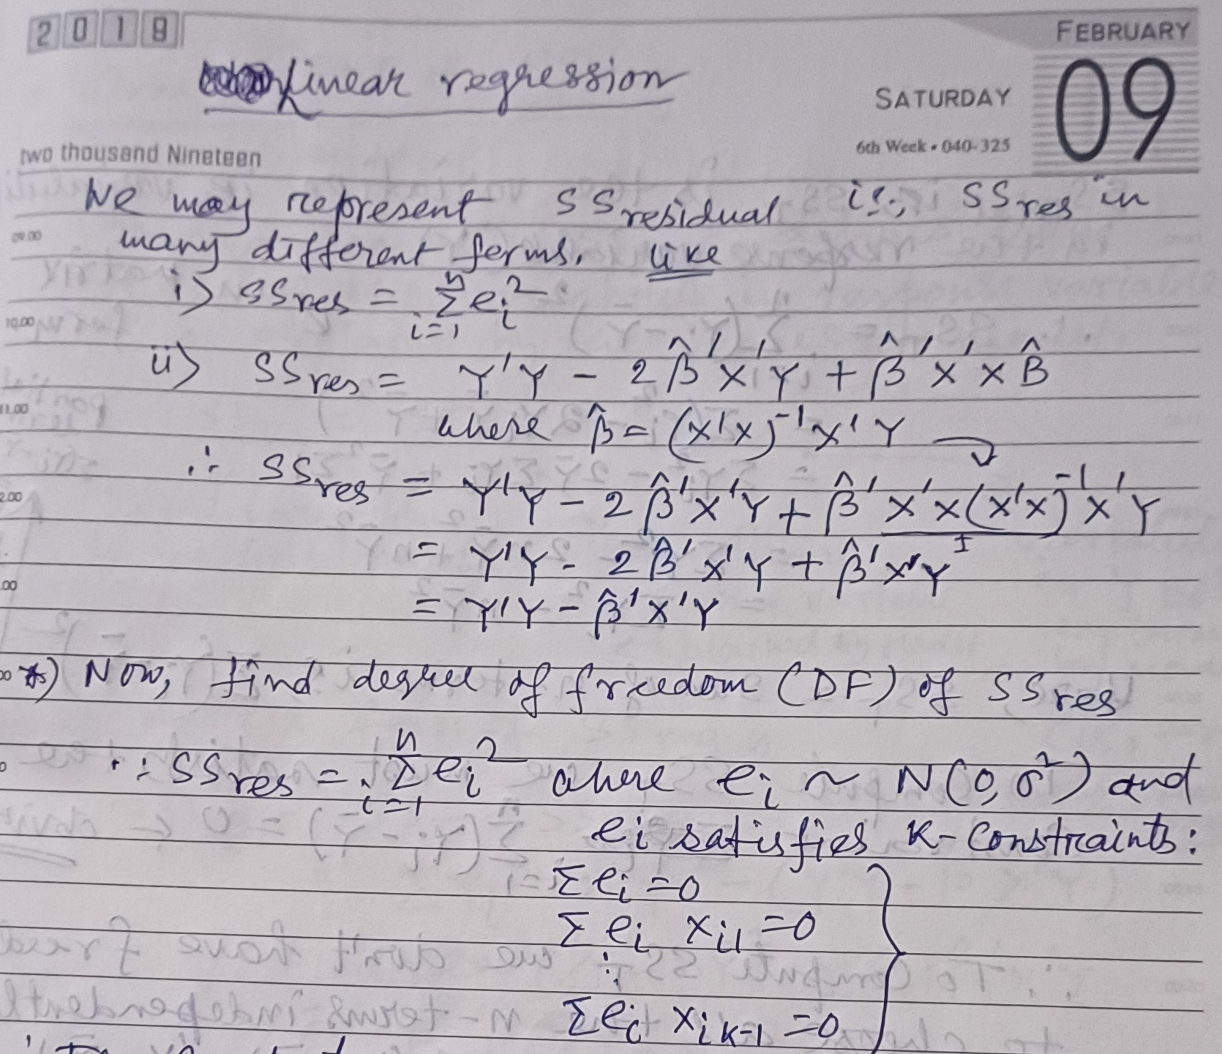
Degree of Freedom (DF) of SS_{Res}

Slide 28
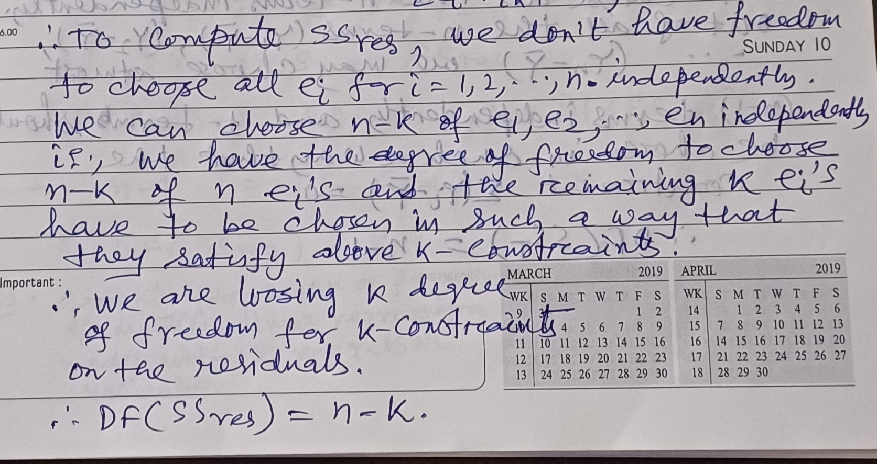
Degree of Freedom (DF) of SS_{Res}

Slide 29
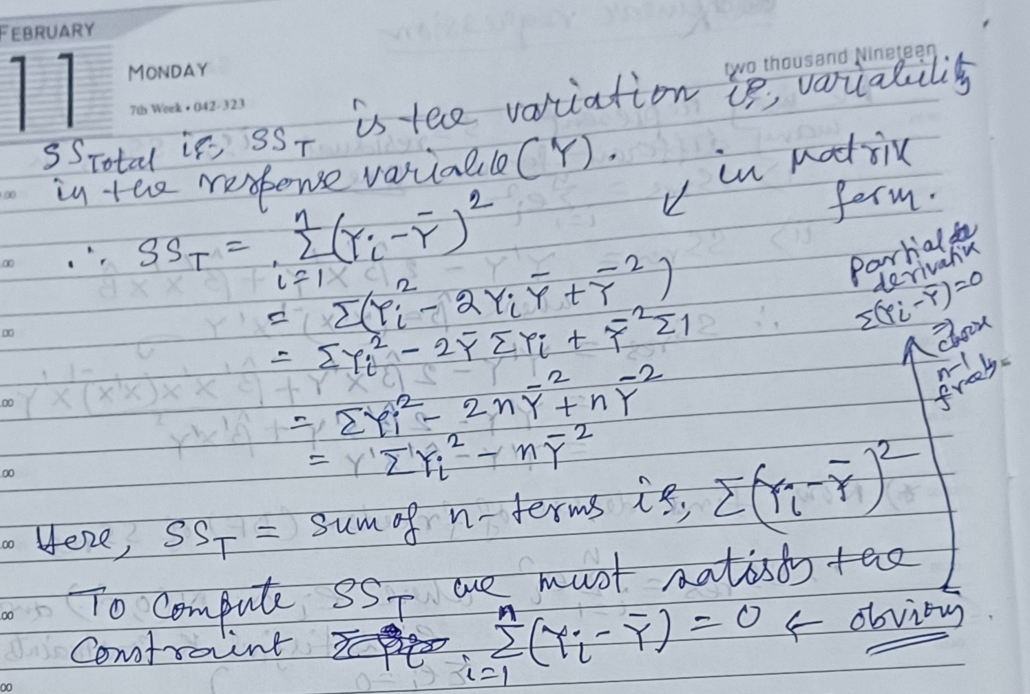
Degree of Freedom (DF) of SS_{T}

Slide 30
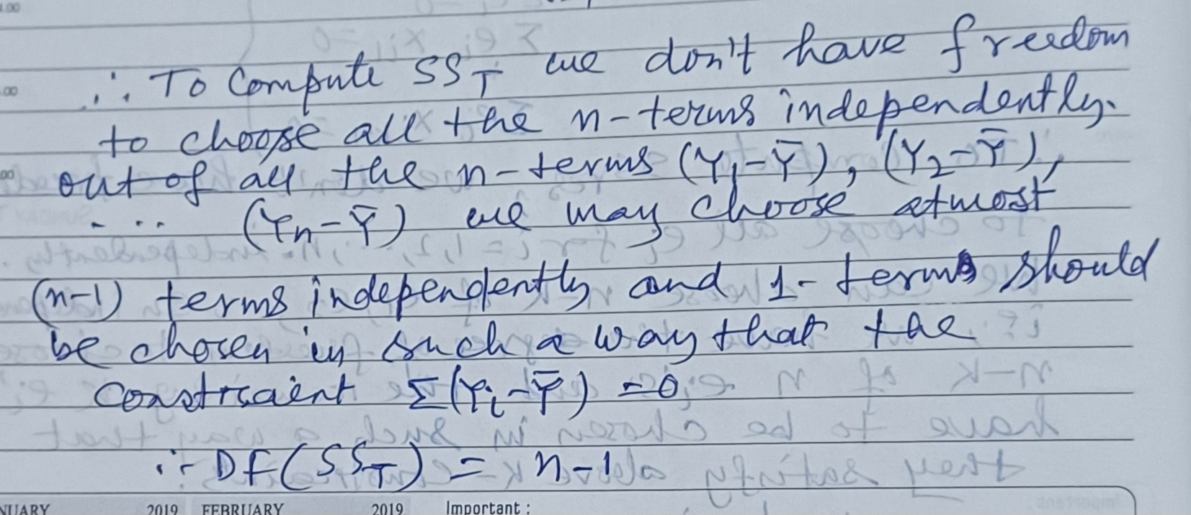
Degree of Freedom (DF) of SS_{T}

Slide 31
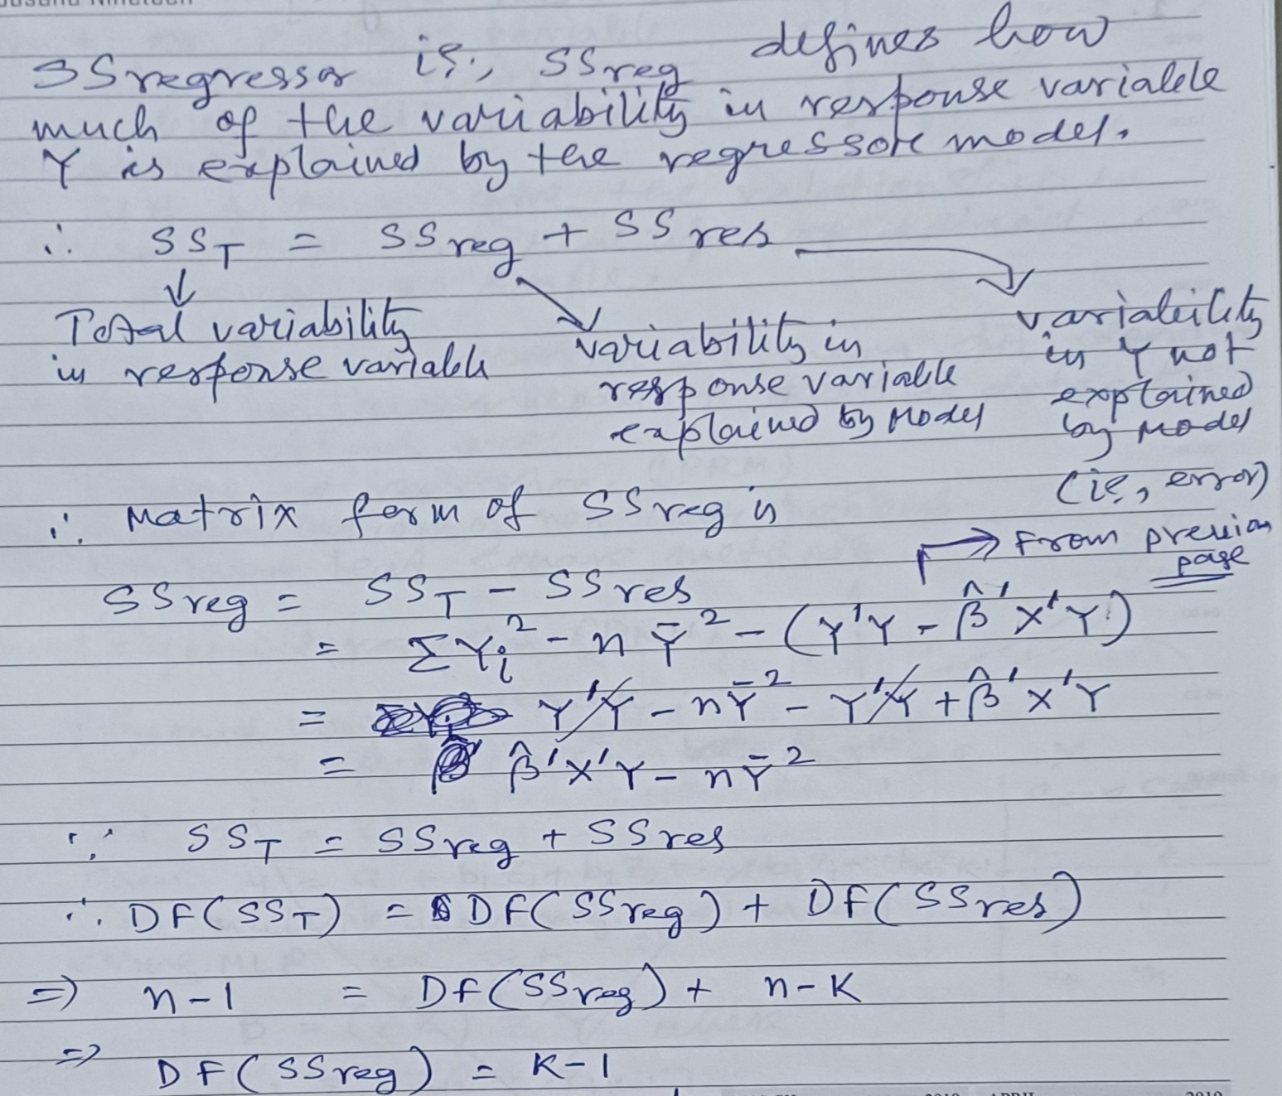
Degree of Freedom (DF) of SS_{Reg}

Slide 32
Thank you

